Slide 1


Mapping the applicant experience of benefit enrollment
USER RESEARCH INSIGHTS
A user research study for human-centered public services // October 2016

Slide 2
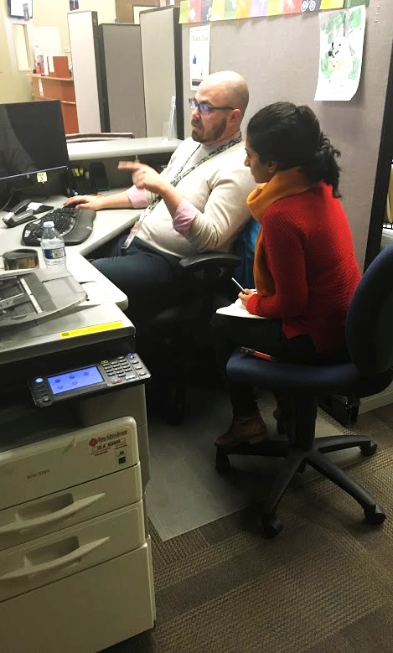
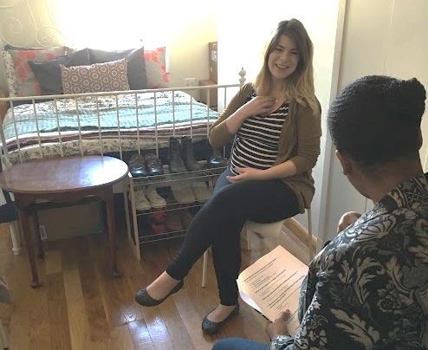
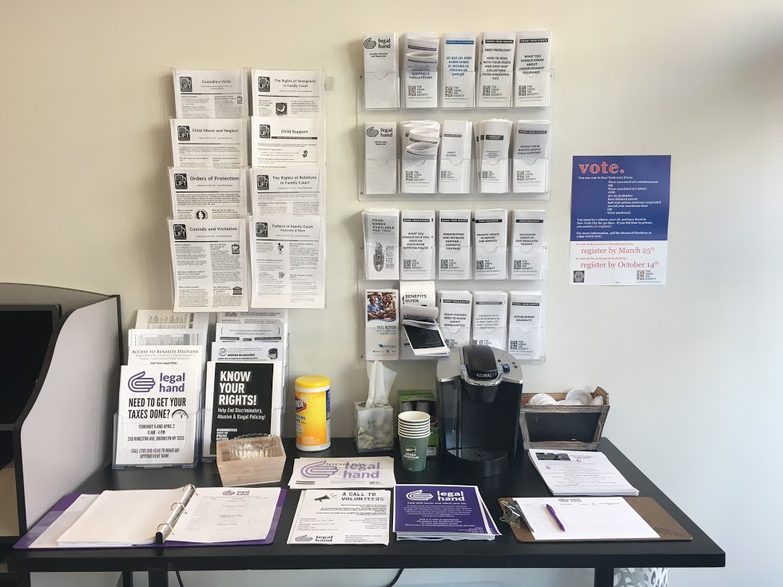
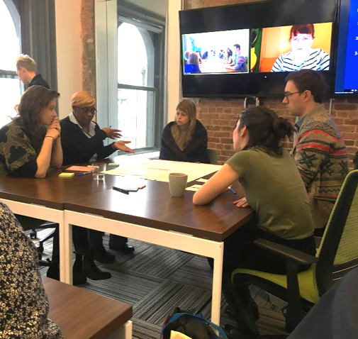
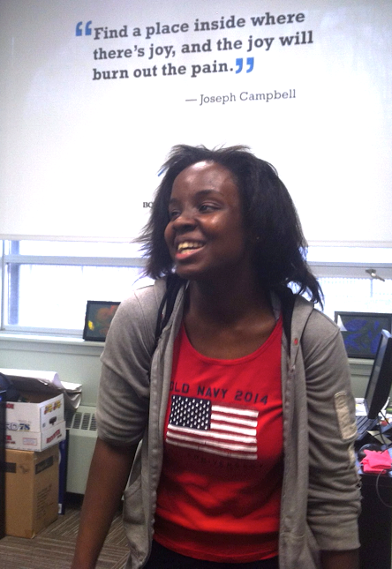
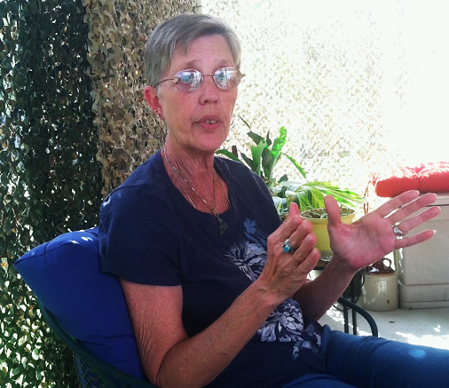

Slide 3
“It's hard enough living with a disability, harder yet when living on a fixed income. But to get the run-around when you’re just trying to get much need help…
…it makes things so much harder.”
Medicaid applicant, Albuquerque, New Mexico
“It feels like brick wall after brick wall.”
“I don’t want email. I don’t want a computer. I want to talk to you. I want you to hear me.”
“I knew I needed help, but I didn’t know where to go.”
“The people behind the computer screen control your life.”

Slide 4
PROJECT MISSION
Accelerate opportunities for the federal government to provide key technology and service improvements to the experience of accessing and enrolling in health and human service programs.

Slide 5
OVERVIEW
In the spring of 2016, the Centers for Medicaid and Medicare and the U.S. Digital Service conducted an extensive qualitative user research study in effort to better understand the steps and applicant experiences in enrolling in public assistance programs.
Based on 82 contextual interviews, site visits and service trials with applicants, non-profit enrollment assistors and local program administrators across seven states, the study underscored the need for simplified, streamlined and less burdensome application processes.

Slide 6
Research focus
What are the steps and experience of enrolling in – or supporting someone to enroll in – multiple benefits?
Investigate enrollment needs, pain points + best practices
Map user journey through the enrollment processes
Build greater understanding of people who use government enrollment systems
USER RESEARCH GOALS

Slide 7
Summary of findings

Slide 8
APPLICANT EXPERIENCE // KEY FINDINGS
Applicants have varying degrees of familiarity with programs, but generally don’t know where to start, often relying on word-of-mouth to determine where to go for info or what to apply for.
Government office experiences can be very difficult, marked by long wait times, hard-to-reach rural or limited transit locations, and dehumanizing staff interactions.
Long wait times for applications to be reviewed causes financial burden and anxiety.
The notification of next steps and renewal parts of any process are routinely the most problematic. Most programs rely on mail to inform applicants, but many people do not have stable addresses and/or cannot read/understand language in notices.
Technology access is a barrier to many, therefore digital-only applications can be a challenge. In-person or phone support is necessary for some.
Third-party assistor support and multi-benefit screening can greatly reduce barriers to enrollment.
Notes:
3 min (this + next slide)

Slide 9
APPLICANT EXPERIENCE // USER STORIES
As an applicant, I need:
The option to determine my eligibility and apply for one or more programs all in one place, in as few steps as possible.
Notifications and feedback loops about my benefits that are reliable, timely, and easy to understand.
To be able to interact with benefits programs through the channel (phone, text, email, in-person) that makes the most sense for my life.
Information that is clear, easy to find, and easy to understand.
Notes:
Clarify if this confirms and if so is additive to ACA methods

Slide 10
ENROLLMENT OPERATIONS // DESIGN PRINCIPLES
The most efficient and family-centered programs...
Take on the responsibility of verifying eligibility, either manually or using existing data, to reduce the burden to applicants.
Deeply invest in increasing efficiency, continuously tracking operations data and analyzing effectiveness of their processes.
Integrate program applications to help serve individuals and families more holistically.
Use technology and multi-channel touchpoints to communicate in ways that help keep people from dropping out during enrollment or renewal.
Empower staff to use their judgment and discretion, moving away from a ‘line worker’ model, increasing effectiveness and satisfaction for both staff and applicants.

Slide 11
Methodology
A USER-CENTERED RESEARCH APPROACH

Slide 12
User-centerd design + research
METHODOLOGY
A QUICK INTRODUCTION

Slide 13
WHAT IS USER-CENTERED DESIGN?
A process for designing a system, service, tool or experience from the perspective of the human users, which emphasizes uncovering user need up front, rapidly designing quick iterations and regularly gathering feedback from users.

Slide 14
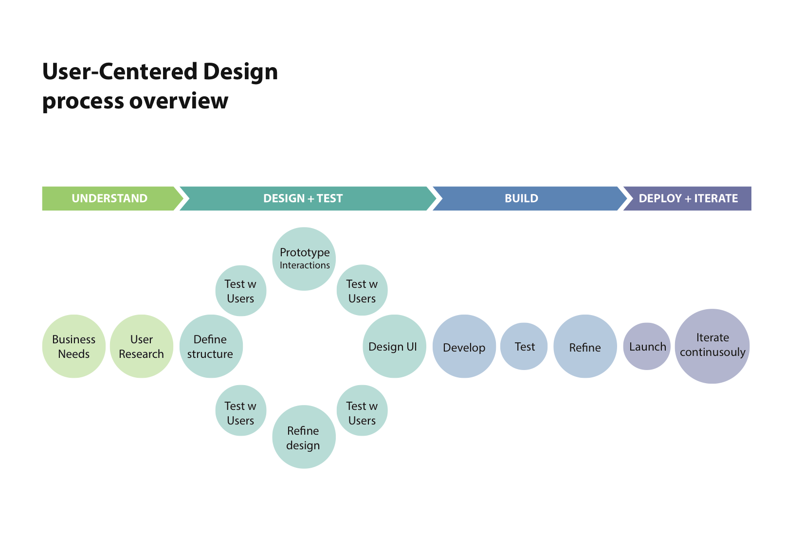
USER-CENTERED DESIGN FOR PRODUCT DEVELOPMENT

Slide 15
WHY INVEST IN USER RESEARCH
“Great products arise out of listening to [people] describe their moments of deep personal pain, as well as profound joy—paying attention to what motivates and moves each of them, and committing yourself to building something that will alleviate their pain and maximize their happiness.”
LUCKY GUNASEKARA, COFOUNDER OF VULCAN LABS, HEALTH IT INNOVATION NON-PROFIT

Slide 16
WHY QUALITATIVE USER RESEARCH?
Historically, government agencies conduct surveys or focus groups to understand our customer/client/users’ opinions about our services. While this kind of data offers value, it does not provide deep insight into the qualitative characteristics of a service experience or the motivations, behaviors or capacities of our clients – the American people.
Design-driven user research approach is less concerned with opinions, and puts more focus on observed patterns of need and experience. This is accomplished by observing how people engage with, react to and make sense of our programs and tools in their native environments. Real-time ethnographic field research in people's homes, at points of service, and at community organizations gives us the ability to develop a complex and nuanced understanding of the way our users experience our services.

Slide 17
Our approach
METHODOLOGY
OVERVIEW OF USER RESEARCH ACTIVITIES IN THIS STUDY

Slide 18
UNDERSTANDING BENEFITS ENROLLMENT
USER RESEARCH // FIELD ACTIVITIES
Contextual interviews Individual converstaions with applicants, assistors and local government employees in their homes, workplaces or non-profits
Shadowing and service trials Observing applicant interactions at assistor + government offices
Site visits On-site in-depth walk throughs of government program operations
Co-design workshop Mapping current enrollment pain points and designing ideal-state solutions with local government and assistors

Slide 19
UNDERSTANDING BENEFITS ENROLLMENT
USER RESEARCH // USER RESEARCH PARTICIPANTS
40 applicants
42 assistors/community-based org staff
6 federal agencies and departments
15 state and local administering agencies
13 think tanks and research organizations
9 startups and screening organizations

Slide 20
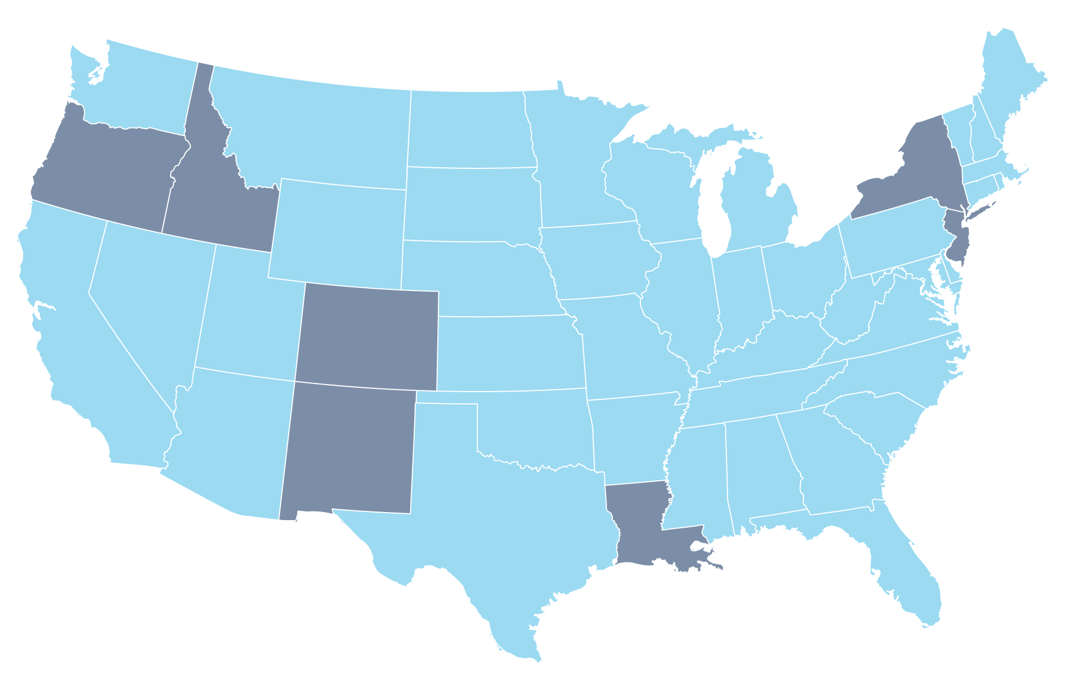
UNDERSTANDING BENEFITS ENROLLMENT
USER RESEARCH // LOCATIONS
Colorado
Idaho
Louisiana
New Jersey
New Mexico
New York
Oregon

Slide 21
The enrollment experience
USER RESEARCH FINDINGS

Slide 22
Applicant stories
ENROLLMENT EXPERIENCE
A SNAPSHOT OF THE PEOPLE WE SERVE

Slide 23

THE ENROLLMENT EXPERIENCE // APPLICANT STORIES
RACHELLE New Orleans, LA
PROFILE
34-year-old veteran
Single mother of two daughters
Relies on the internet for info, but doesn’t own a computer
NEEDS
More clarity on which benefits she is eligible for.
More support and empathetic treatment from government workers.
Data sharing across programs, so she’s not reliant on maintaining paper files to prove eligibility.
ATTITUDES
Frustration with eligibility requirements that don’t feel reasonable.
Feels grateful for the support of her local CBOs in New Orleans.
A lingering fear that she’s never many steps away from having to live on the street.
“I’m not asking someone to sponsor my life. I’m just trying to feed my kids.”
RACHELLE’S STORY
Rachelle, a military veteran originally from St. Louis, ended up homeless in New Orleans in her late teens. She eventually returned to St. Louis to be with her family, but was displaced after a house fire last year, at which point Rachelle and her daughters returned to New Orleans. Once there, she reconnected with the extremely supportive network of community-based organizations who helped her back in her teens, and has felt significantly more supported and in control of her life circumstances since then.
Even though she’s connected with local organizations, Rachelle has struggled to enroll in benefits over the years. She feels judged and disrespected by the enrollment staff she’s had contact with, and feels like no matter how hard she prepares to bring the right papers, it always seems like it’s not enough.
Rachelle experienced sexual abuse during her military service, and suspects her difficulty receiving VA benefits may be influenced by the fact that she reported her abuse. Additionally, securing a new job ultimately disqualified her from continuing her food stamps assistance, which she still needed to make ends meet. Losing her paperwork in the house fire has made proving her eligibility more difficult.
Despite her struggles, Rachelle has taken college courses and recently graduated from a hospitality program, has a good job at a new hotel, and has her daughter in good schools.
Notes:
Should we add user story from Kathy Edin and Ideo?

Slide 24

THE ENROLLMENT EXPERIENCE // APPLICANT STORIES
GEORGE New York, NY
PROFILE
35-year-old single father
He and his son suffer from multiple health issues
Very comfortable with technology
NEEDS
Ability to check case status more easily
More frequent, informative notifications, through multiple channels such as email and text.
Awareness of the channels through which he can learn about and apply for benefits.
ATTITUDES
He prefers to figure things out for himself and doesn't want to feel like a burden to anyone or take advantage of the system.
Eager to move out on his own with his son and provide a good life for him
“Sometimes, I don’t know how to ask for help.”
GEORGE’S STORY
George was living in Oakland, CA when his girlfriend had a severe bipolar episode a week after their son’s birth. As a result, he was unexpectedly given sole custody of his newborn son. He managed to get by until his landlord defaulted on his mortgage and evicted George. He returned to NYC to live with his mom and grandmother, who are both receiving public assistance, only to find they were about to be evicted for not making rent payments. He and his brother paid off their overdue rent using cash assistance.
George has diabetes and stage 3-4 kidney failure/chronic kidney disease, and his young son has asthma and epilepsy. Their health issues prevent them from staying at local shelters when needed.
Most of their care comes from the ER. It’s difficult for George to stay on top of things since his energy goes to keeping himself and his son healthy.
George has dreams for his future, and is taking college prep courses. He visits a therapist and counselor at the center where he takes classes. They point him towards assistance programs, but they can’t help him enroll. He really has very little idea of what programs are available to him. Despite the fact that William is tech-savvy, most correspondence with assistance programs comes through the mail, which adds to his burden.
Notes:
Should we add user story from Kathy Edin and Ideo?

Slide 25
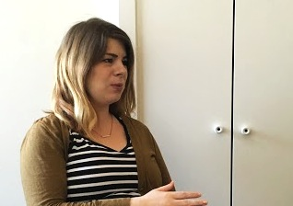
THE ENROLLMENT EXPERIENCE // APPLICANT STORIES
SARAH New York, NY
PROFILE
29-years old expecting mother
Pursuing a Master’s in social work
Very comfortable with technology
NEEDS
Awareness of the various channels through which she can apply for benefits.
Assistance traveling back and forth from medical appointments and agencies.
Information about how to transfer her benefits when she moves home to PA.
ATTITUDES
Appreciates the hard work that goes into supporting people through tough times.
Values community and relies heavily on personal networks for support.
As a digital native, wishes government programs were more “with the times.”
“The day I got Medicaid was the best day of my life.”
SARAH’S STORY
Sarah came to New York City to continue her career in social work. Right before she was set to start her graduate studies in social work, however, Sarah found out she was unexpectedly pregnant. Sarah didn't know how she would afford school while raising a baby on her own. Feeling desperate, daunted, and overwhelmed, she reached out in many directions, including sending a letter to President Obama, which is how we connected with her.
During this time, Sarah found support in her local Mormon community. As a social worker, she had a sense of what was available to her, so she knew she needed to enroll in WIC and Medicaid, though she wasn’t totally sure where to start.
A friend recommended she go to Planned Parenthood for Medicaid, which she described as an incredibly helpful, simple process. “I walked in and walked out with Medicaid that day.”
WIC was much harder to figure out on her own. As a single, pregnant woman with limited income, she struggled to trek to different offices for regular WIC appointments and has experienced humiliation in using her WIC benefits in grocery stores. Sarah is aware of her own privileges and awareness, and her background in social work gives her empathy and compassion for others in her shoes.
Notes:
Should we add user story from Kathy Edin and Ideo?

Slide 26
User needs
THE ENROLLMENT EXPERIENCE
THEMES FROM THE JOURNEY TO ENROLLMENT

Slide 27
APPLICANTS // USER NEEDS
As an applicant, I need…
Information that is clear, easy to find, and easy to understand.
WE HEARD:
Applicants don’t know where to start - often relying on word-of-mouth to determine where to go for info or what to apply for.
Applicants often get the run-around: the website is down, the office is closed, the help number is busy or not accepting calls.
Without easy access to reliable information, applicants can be deterred by misinformation (eg, that applying for benefits could affect your citizenship status; that the wait time to receive a benefit is too long to be worth applying for, etc.).
Application forms are long and written in confusing terms. Many applications find they need the help of an assistor to complete their enrollment.
Notes:
Should we add user story from Kathy Edin and Ideo?

Slide 28
APPLICANTS // USER NEEDS
As an applicant, I need…
Interactions with staff and offices that are accessible and encouraging.
WE HEARD:
Applicants often feel disrespected and unsupported by workers at government offices, and report having the impression that staff don’t want to help them or are sometimes not sufficiently trained or are lacking up-to-date information.
Wait times at government offices and on phone lines are prohibitively long and often feel understaffed.
Getting to government offices can be very difficult in rural areas, in cities with limited public transit, or for elderly, disabled, or pregnant applicants.

Slide 29
APPLICANTS // USER NEEDS
As an applicant, I need…
A faster process with less waiting and uncertainty.
WE HEARD:
Many applicants experience inexplicable waits between when they submit an application and when they are deemed eligible, or when they are deemed eligible and when they begin actually receiving their benefits. Those long stretches without benefits can be devastating to an applicant’s life circumstances.
Applicants have to take off work to visit offices or wait on hold to talk to someone - for many, this is a barrier to enrollment.
Applicants often feel like they are submitting their documents or questions into a black hole, waiting for long periods of time with no response.

Slide 30
APPLICANTS // USER NEEDS
As an applicant, I need…
A variety of options for how
I interact with benefits programs.
WE HEARD:
Preferences for how to engage with programs varies from person to person, and those are usually strong.
Applicants who prefer online interactions are often more comfortable with technology, and/or they want to avoid the sense of discrimination, stigma or embarrassment that many feel with visiting a local office or having to reveal private information to another person.
Applicants who prefer in-person interactions appreciate being walked through the process and having their experience tailored to their needs; the personal connection helps them avoid feeling overwhelmed or nervous.
Many applicants who prefer phone interactions appreciate the personal, human contact, but use the phone since visiting offices can be prohibitively difficult.

Slide 31
APPLICANTS // USER NEEDS
As an applicant, I need…
Notifications and feedback loops that are reliable and timely.
WE HEARD:
Reliance on letter mail as the only form of correspondence is problematic, since many applicants do not have stable addresses, and it is easy for mail to get lost or delayed.
Even when notices do reach applicants, information and instructions are often hard to understand (not at the right reading/comprehension level, not in the applicant’s native language, etc.).
If notices aren’t received, applicants often discover there have been changes to their benefits once it’s already too late (e.g. at the doctor’s office or grocery store checkout when they’re trying to use them).
Notes:
Should we add user story from Kathy Edin and Ideo?

Slide 32
APPLICANTS // WORKS WELL
As an applicant, it’s helpful when I can…
Learn about and apply for assistance though an independent organization.
WE HEARD:
The personal connections fostered at CBOs helps reassure applicants and makes the process less intimidating.
Staff at CBOs tend to find meaning in helping others, and therefore treat applicants with more respect.
Wait times at CBOs are almost always much shorter than at government offices.
Notes:
Should we add user story from Kathy Edin and Ideo?

Slide 33
APPLICANTS // WORKS WELL
As an applicant, it’s helpful when I can…
The option to determine my eligibility and apply for one or more programs all in one place.
WE HEARD:
Screening for eligibility across multiple programs in one place often exposes applicants to programs that they wouldn’t have otherwise known to seek out.
While some applicants will choose to apply for only one program, the option to apply for multiple programs altogether in one sitting greatly improves experience (less time spent shuttling between many offices, less exposure to treatment at government offices).
Notes:
Should we add user story from Kathy Edin and Ideo?

Slide 34
The journey to public assistance
ENROLLMENT EXPERIENCE
STEPS, PAIN POINTS + BEST PRACTICES FOR PEOPLE SEEKING TO ENROLL

Slide 35

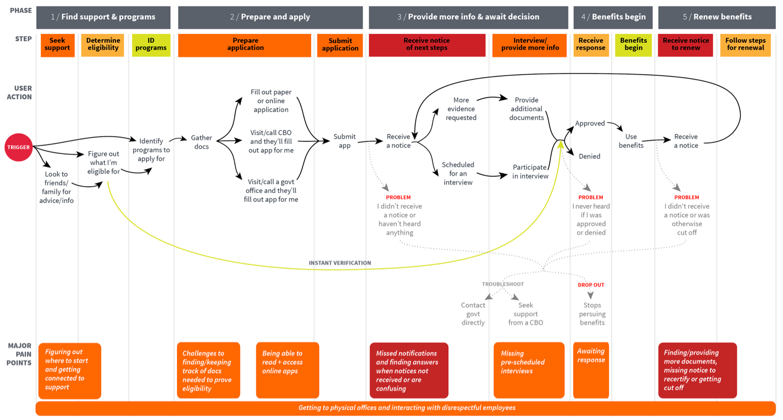
APPLICANT JOURNEY
Notes:
Change “Determine eligibility” to “Inform eligibility”
Change “instant verification” to “automated determination”

Slide 36
APPLICANT JOURNEY // PHASE 1
PAIN POINTS: FINDING SUPPORT
Finding the right place to start is hard.
Information about programs and qualifications is confusing.
Understanding the differences and qualifications for multiple programs can be complex.
Lots of calling, googling, leaving messages, etc. to find the right office -- often hard to reach and a sense of being given “the run around.”
People looking for support are sometimes completely disconnected from the groups available to help and without contacts who’ve already been through an enrollment process, may not know how to find these groups. Many find it hard to know which sources to trust.
“I don’t want to become and expert on this stuff but I have learned I have to be.”
“If you don’t know somebody who’s been through the process, then you just don’t know what to do.”
Searching online can help for some, but leads to overwhelming amounts of information in language that can be hard to understand.
Information that is presented in technical and formal legal/policy language that are confusing and opaque to applicants.
“The bureaucratic language on human services websites works for policy makers, but it doesn't work for people. Language ...walls off people.”
Many people worry that participating in one program will disqualify them for others.
Immigrant applicants often have concerns about how citizenship will impact eligibility, or program participation will put them at risk.

Slide 37
APPLICANT JOURNEY // PHASE 1
WHAT WORKS WELL: FINDING SUPPORT
Informal social networks help people get connected to support.
The support, comfort and info provided by CBOs offers a leg up in preparing to apply for services.
Learning about programs while using/enrolling in other programs is helpful.
Screening for multiple benefits helps applicants get setup quickly and more easily.
When an event triggers someone to seek out assistance, they almost always start by asking friends, family, religious or community institutions for advice.
“I looked to this community of single mothers + Mormon friends for support, people who’ve been through this. They had such good recommendations.”
Because the process feels daunting, human contact with someone who understands the process eases anxiety.
Applicants are less likely to make mistakes or lose hours to long wait times when they connect with a Community Based Organization (CBO).
“When I started coming here and it was way easier. This place is just a huge stress relief. I don't have to use all my time that I could be using to find a job standing in line.”
Applicants reported positive responses when they were informed about specific services available to them from programs they were already connected to. For example: utility support resources listed on heating bills.
“I got my Medicaid when I went to renew my childcare support; they let me know I was eligible which I didn’t know about.”
The application process feels much less daunting and much clearer when applicants understand what is available to them all together at the same time.

Slide 38
APPLICANT JOURNEY // PHASE 2
PAIN POINTS: DOCUMENTS
PAIN POINTS: SUBMITTING AN APPLICATION
Gathering documents required to prove eligibility can be challenging and stressful.
Applicants experience anxiety and additional burden if they apply in-person without the correct documents in-hand.
When applicants arrive at enrollment offices without all of the documents required, it’s a burden to return home and resubmit. People try to figure it out up front, but are easily confused by the different requirements of different programs.
“I actually came way over prepared and they didn't need half of it. But it's so annoying to go through these processes where if you forget one thing, you get sent home and then you have to come back again. In New York that's a lot of transit and it feels terrible.”
APPLYING WITHOUT SUPPORT
Those with limited language or tech literacy really need a helper to apply.
Many people -- especially older people -- felt a strong desire for a human hand to help them through. Some feel unable to understand the apps/process on their own.
NO CONFIRMATIONS
No tactile feedback when applying online or in the mail. Incites the ‘sending into a black hole’ feeling.
"If you do fax things in you might be faxing into a void... You can’t see if it’s received and you get no confirmation...”
Many people in poverty have limited access to old paper documents such as pay stubs or leases. Locating this evidence can slow down the applicant’s timeline.
There is general confusion around the need to provide the same information multiple times for different applications.
People are often unclear on which documents they need for which programs and at which step of the process.

Slide 39
APPLICANT JOURNEY // PHASE 2
PAIN POINTS: SUBMITTING AN APPLICATION continued…
ONLINE APPLICATIONS
Many people have difficulty accessing or using online applications.
While digital is preferred by some, many applicants do not feel comfortable using computers and are unsettled when required to apply online.
Most online applications are not mobile-friendly. Some online systems aren’t reliable/available all the time.
Not all applicants have easy or reliable internet access.
“What if I press the wrong button? What if I miss something? Am I disqualified?”
ONLINE APPLICATIONS
Applying for multiple programs with different applications is confusing.
“You can’t go online and put in all your info, and everything you’re eligible for pops up. No, it’s a one-by-one process; a different site for this and that.”
PAPER APPLICATIONS
Good for those with low technology access but can feel burdensome to others.
Some people find paper forms take longer and are hard to complete. Others feel heightened concerned about paper forms getting lost in the mail or at program offices.
APPLYING IN PERSON
Office locations can be hard to get to, require long wait times and feel unwelcoming.
For those working, it can be very difficult to get to government offices during open hours. Limited public transit or long distances create barriers for getting to physical offices.
Many feel unwelcomed and unsupported by the staff at local offices. There is sometimes a sense of shame or embarrassment in going to a government ‘welfare’ office.
"It feels like nobody cares, they just want you to go away. It’s heartbreaking to have to deal with that in every interaction. I’m just preparing for stress.”

Slide 40
APPLICANT JOURNEY // PHASE 2
WHAT WORKS WELL: DOCUMENT MANAGEMENT
Applicants and CBOs have little tricks for trying to keep track of all paperwork needed/submitted.
CBOs keep backups and copies for applicants in case of processing problems.
Applicants feel grateful and relieved when CBOs are able to help keep track of all their physical materials on file.
“They made the application process really simple. They took all my documents, submitted all the paperwork, and I just did the phone call interview. It was so much easier than I ever anticipated.”
Digital document uploading helps applicants, CBOs and government offices.
When applicants can take and scan pictures of documents this greatly eases the challenge of keeping track of all required paperwork.
For governments, this improves quality of image over faxed documents, and reduces churn as it offers less paper to process.
With so many opportunities to lose track of physical documents or important steps, both applicants and CBOs create copies of everything in a variety of ways such as phone screenshots, texting or emailing things as a backup, or making paper copies.
“I always take pictures of my client’s cards and papers in case she loses it or it doesn’t make it into the application.”
The application process for SNAP is easy. With her help, I feel like I don't have to do anything. She keeps it all together for me

Slide 41
APPLICANT JOURNEY // PHASE 2
WHAT WORKS WELL: DIGITAL TOOLS FOR STREAMLINED PROCESSES
AUTOMATIC DETERMINATION
Same-day determination and enrollment eliminates the most painful parts of the application process.
There are so many opportunities for people to drop out of the enrollment process with every additional step and interaction required. Verifying and enrolling at a single touchpoint improves the experience and speeds up the process for them and the agency.
“I went to Planned Parenthood and walked out with Medicaid the same day. This was one of the happiest days of my life. I was worried about everything turning upside down and losing it all.”
APPLYING ONLINE
Easy to understand, mobile-responsive and accessible websites improve usability of online applications.
While not all applicants will be comfortable with digital tools, many expressed a preference for being able to submit applications online, using mobile devices. It is crucial that all digital tools be designing with feedback from users and meet the highest standards of web accessibility.
“I did everything online. It was so easy and basic. It was kinda like using TurboTax. I never even had to step into the office.”
MULTI-CHANNEL OPTIONS
Allow applicants to apply over the channel that works the best for their needs.
Given the range of familiarity with and access to online tools combined with personal preferences, applicants appreciate the option to choose how to apply.
“Some people are embarrassed to go in person; applying online makes the uncomfortable feeling go away. No one knew I was even there.”
“My friends all apply online, but I prefer to go in person because I like talking to a human.”
INTEGRATING APPLICATIONS
Applying for more than one program at a time significantly reduces anxiety and burden for applicants.
We observed great burden to applicants in managing and keep track of multiple applications, on different timelines. When applicants are able to apply to a suite of services up front, they feel a sense of ease and enrollment processes see reduced process churn when all information is gathered and verified at one time.

Slide 42
APPLICANT JOURNEY // PHASE 2
WHAT WORKS WELL: 3rd PARTIES AS A PROXY
COMFORT AND WARMTH
CBOs treat applicants as whole people, creating a sense of ease and support often not felt in government offices.
CBOs try hard to meet people where they are, to provide clarity and structure to an overwhelming and opaque process. Applicants time and again spoke of how much this improved their well being.
“This place makes me feel so comfortable and I don't feel shameful. They are very respectful and helpful. It's so welcoming. They are good people.”
EXPERTISE
3rd parties can offer advice and understanding of the system, taking the burden off of applicants to become ‘experts.’
CBOs invest in staying up to date on rules and process so that their clients don’t need to. Applicants are relieved when they do not need to try to understand the complexities.
“The application process for SNAP is easy here. With her help, I feel like I don't have to do anything. She keeps it all together for me.”
SUPPORT FOR MULTIPLE PROGRAMS
Because managing multiple benefits can “feel like a full time job” the support of CBOs on this front help people keep track of everything.
Applicants who work with CBOs expressed great appreciation for the support in managing processes, documents and timelines which can feel intimidating on their own.
“They made the application process really simple. They took all my documents, submitted all the paperwork, and I just did the phone call interview. It was so much easier than I ever anticipated.”
INTEGRATING APPLICATIONS
Applying for more than one program at a time significantly reduces anxiety and burden for applicants.
We observed great burden to applicants in managing and keeping track of multiple applications, on different timelines. When applicants are able to apply to a suite of services up front, they feel a sense of ease.

Slide 43
APPLICANT JOURNEY // PHASE 3
PAIN POINTS: NOTIFICATIONS
PAIN POINTS: TROUBLESHOOTING
MAIL IS NOT A RELIABLE CHANNEL
Mail-based notifications regularly are not received.
Much of the applicant demographic has unstable living situations; many people do not regularly receive/have access to mail or do not have a consistent mailing address. When notices are only delivered via mail, many applicants miss important info.
NOTICES ARE CONFUSING
Written language in notices is often difficult for people to understand.
Many applicants expressed difficulty in
making sense of the written documents they receive, thus missing steps or losing their benefits.
WHERE DO I GO FOR HELP?
People have a hard time figuring out which number to call or office to visit.
Applicants aren’t always entirely clear on who to contact in the even that something goes wrong.
UNDERSTAFFED
Demand for support seems to exceed size of workforce, resulting in long wait times.
“There just aren’t enough people to field all of the calls. You’ll get transferred and have to wait 20, 30 minutes to talk to someone else.”
SPEAKING MY LANGUAGE
If they do reach someone, applicants do not always have full understanding of what they are being told.
Applicants aren’t always familiar with the policy or organizational terms they come in contact with, and this proves particularly troublesome when they are trying to understand what has gone wrong with an application.
“They ask ‘Do you want to speak with an agent or a counselor?’ What do those words mean? I can't tell the difference!”
“SHOUTING INTO THE VOID”
Lack of response when looking for answers makes people lose confidence in the process.
When applicants can’t reach someone directly, many will leave voicemails, send emails or letters. If their messages are not returned, this adds discomfort and anxiety – particularly when applicants are unsure of the status of an application.
“It’s so frustrating. If you leave a voicemail it feels like you’re shouting into the darkness. You never know if you’ll hear back so just keep trying.

Slide 44
APPLICANT JOURNEY // PHASE 3
PAIN POINTS: INTERVIEWS
PRESCHEDULED INTERVIEWS
Application completion suffers when applicants are sent prescheduled interview times.
Repeatedly we heard about people not receiving, understanding or entirely missing prescheduled appointments. Prescheduled interviews don’t account for applicant’s work schedules, transit accessibility etc. – and applicants are often unsure of what step to take if they miss or cannot make the predetermined time. This step in particular keeps many applicants from completing their application, and many site frustrating at needing to restart the application process as a result of missing a prescheduled interview.
“They send you a notice for a specific time and date you have to be available to take the interview call and if you don't see the notice or can't get to your phone in time, then too bad, you don't get the benefits and you have to start over.”
IN-PERSON INTERVIEWS
Many applicants have a difficult time getting to offices, which can cause financial and physical burden.
Many people who work are required to take time off to attend in person interviews, and limited public transpit options can make a short interview become an all day affair.
Applicants prefer to choose between a phone and in-person interview, and to have the option to schedule the interview for a time that fits into their schedule.
A SENSE OF DISRESPECT
Many applicants find the experience of meeting with government staff unpleasant. This feels disrespectful and hurtful.
While the in-person office experience varies widely between localities, we heard and witnessed the hardship caused when applicants feel mistreated by front-line staff.
"It feels like nobody cares, they just want you to go away."
“They make me feel like I’m not human.”
“It’s always heart-wrenching to send people into the SNAP office -- it’s a whole day of being treated badly.”

Slide 45
APPLICANT JOURNEY // PHASE 3
WHAT WORKS WELL: TROUBLESHOOTING AND IMPROVING COMMUNICATIONS
PLAIN LANGUAGE
Write all applicant communication in plain language, designed and tested with applicants to ensure people with limited and low literacy clearly understand all information.
Process churn, customer support demand and applicant anxiety is improved upon when written communication follows plain language guidance, and is regularly tested with applicants so as to ensure comprehension. Ensure this applies consistently to all channels of written communication – letters, website content, email notices, etc.
When relevant, provide support and written communication in non-English languages as well.
MULTI-CHANNEL REMINDERS
Provide multiple channels for communicating with applicants – email, written mail, text, phone calls – and offer applicants the option to choose their preferred channel to increase speed and reliability of applicant response time.
Given the instability of permanent mailing addresses and the range of comfort with technology, enrollment programs which offer applicants the option to receive notices and updates via the channel of their choosing see swifter, more reliable response rates. For applicants, this gives them the option to engage in the way that fits most seemlessly into their lives.
PROXIES
Send notices to 3rd party representatives (CBOs, family members, etc.) so that applicants more reliably receive notices.
When applicants have the option to list a family member of 3rd party organization as their primary point of contact, challenges with changing addresses or unreliable phone service are curbed.
Provide official representative access the applicant’s full case materials.
Applicants and 3rd party representatives articulated a strong desire for designated reps to be able to see case status, applicant history and other related documents retained by enrollment programs. This aids in troubleshooting and ensuring all parties are referencing the same materials.

Slide 46
APPLICANT JOURNEY // PHASE 3
PAIN POINTS: USING BENEFITS
HOW TO USE BENEFITS
Applicants don’t always know where to start or how to make use of programs once they’ve been approved.
STIGMA OF USE
Perceived or real, many applicants feel stigma in the day-to-day experience of using their benefits.
In some instances, when applicants are approved, they do not always understand or receive notice of what steps they need to take. Many programs take effect right away while others may take weeks or months to begin, leaving applicants confused and unsupported while they have already been enrolled.
Applicants do not always know where their benefits are accepted. SNAP and WIC users, for example, site initial struggle in determining which kinds of foods are covered.
“I didn’t get my Medicaid card for quite a while. I was sick but didn’t think I could get care until my card came. When I finally went to the doctor after the card showed up, they told me I didn’t even need it.”
While health assistance programs are more integrated into the ecosystem of care delivery, the lived experience of using programs like WIC and SNAP was often described by applicants as humiliating.
People expressed a desire for the use of EBT and food stamps to be more integrated into regular forms of payment, and for it to cover a healthier and broader range of foods.
“The first time I tried to use WIC at a grocery store, I was horrified. They were shouting over the loud speaker to find out if each food in my basket qualified – and half didn’t because it only covers sugary stuff, no fruits and veggies. I’m there, holding up the whole line with people staring me up and down. It was very humiliating.”
"When people find out you’re on Medicaid, they treat you like dirt."

Slide 47
APPLICANT JOURNEY // PHASE 3
PAIN POINTS: MISSING RECERTIFICATION WINDOWS
PAIN POINTS: MULTI-PROGRAM RENEWAL
Much like other events which require notification, renewal notices sent only through mail often do not get received and/or are misunderstood.
Many applicants discovered they’d missed the renewal window as a result of undelivered mail or lack of comprehension of the notice language. This is particularly challenging as it sends people back to the beginning of the application process, which adds burden to both applicants and enrollment processes.
Limited renewal periods make it easy for people to miss opportunities to renew, and thus are sent through re-enrollment all over.
Applicants aren’t always familiar with the policy or organizational terms they come in contact with, and this proves particularly troublesome when they are trying to understand what has gone wrong with an application.
“Cases close very quickly, but open very slowly.”
Applicants drop out of programs unknowingly if requirements change without their knowledge/understanding.
When applicants have been enrolled in one or more programs for multiple years, they often skip over the fine print or miss details about changes to recertification processes. This often results in applicants suddenly losing their benefits.
“I had been on food stamps, but when I got a job they cut me off without letting me know why.”
People who need to maintain enrollment in multiple programs cite confusion in managing multiple recertification processes.
Recertification requirements and timelines for vary between programs, and people enrolled in more than one program often find themselves struggling to keep track of and keep up with these many overlapping processes.
“Many of our clients think they’ve recertified for all their benefits, when they’ve only just handled one of them. It’s genuinely confusing.”
“If I wasn’t working there, I wouldn’t know all the programs … hard time when speaking with someone…you can’t just call and speak directly with someone. … have to leave a message … but you miss their call, you can get denied … It takes up to 30 days before you …sign up before you even need it.”

Slide 48
APPLICANT JOURNEY // PHASE 3
WHAT WORKS WELL: TROUBLESHOOTING AND IMPROVING COMMUNICATIONS
CONSISTENT ROUTINE
When applicants have a clear understanding of steps and know what to expect, they can plan and prepare for renewal periods.
For applicants who have been through renewal in the past or who are able to very clearly keep track of what’s being asked of them and when, they will plan ahead and make accommodations to ensure they submit materials on time. This proactive approach leaves applicants relying less on short notice letters and notifications, which reduces their risk of missing enrollment windows.
“Every 2 months, I know that I’ll need to walk 15 min to my WIC office and refill my vouchers. I know it’s about 15 to 40 minute wait. I wish it were less, but since it’s always the same, I pretty much know what to expect.”
3rd PARTY REMINDERS
Assistors will often remind their clients of upcoming renewal periods and requirements, reducing likelihood of missing renewal windows.
When applicants look to assistors to support their enrollment from the start, these 3rd parties will often take on the role of tracking program requirements, processes changes and renewal timelines. This creates a helpful barrier between applicants and program offices, as 3rd parties are able to regularly communicate more reliably with their clients and help prepare them well in advance to keep them enrolled.

Slide 49
Design principles
PILLARS OF USER-CENTERED ENROLLMENT SERVICES

Slide 50
DESIGN PRINCIPLES
Applicants have more success when government enrollment services...
Take on the role of verifying applicant eligibility, reducing burden for applicants and churn in the process of eligibility determination.
WHAT THIS MEANS FOR SERVICE OPERATIONS:
When data is available to provide instant verification or program staff take on the responsibility to manually verify applicant eligibility, the amount of back-and-forth between applicant and agency drops significantly, improving timeliness in response to applicants and internal efficiency.

Slide 51
ENROLLMENT OPERATIONS // DESIGN PRINCIPLES
Applicants have more success when government enrollment services...
Continuously invest in increasing efficiency.
WHAT THIS MEANS FOR SERVICE OPERATIONS:
Evaluate the effectiveness of current practices at regular intervals which helps program staff identify ways they could improve.
Invest in training and supporting workforce culture change that allows for family-centered and efficiency-based operational models.
Reducing the number of hands on each application minimizes clerical errors and steps in the process.
Web-based case management systems help reduce reliance on cumbersome paper forms and files, and decentralizes information so that data can be accessed anywhere.

Slide 52
ENROLLMENT OPERATIONS // DESIGN PRINCIPLES
Applicants have more success when government enrollment services...
Are integrated, to help serve individuals and families more holistically.
WHAT THIS MEANS FOR SERVICE OPERATIONS:
Taking a holistic view of the applicant and their family, program staff can suggest additional programs that an applicant may be eligible for beyond the programs they are actively seeking out.
Ask applicants for up-front consent for data-sharing across programs helps program staff assess an applicant’s eligibility must faster and more accurately.
Provide ways to apply for multiple benefits in one stop greatly improves applicant’s experience and increases their likelihood of successfully enrolling in all the programs they are eligible for.

Slide 53
ENROLLMENT OPERATIONS // DESIGN PRINCIPLES
Applicants have more success when government enrollment services...
Use technology and multi-channel touchpoints to ensure people do not drop out during enrollment or renewal.
WHAT THIS MEANS FOR SERVICE OPERATIONS:
Measure and track user engagement and drop off at each stage of the process.
Auto-generate notifications helps ensure applicants don’t miss critical changes to their benefits, and helps inform them of other programs they may be eligible for.
Enable the option for people to verbally sign via telephonic signature for phone applications and renewals.
Ensure information resources have good multi-language support and use clear, plain language to help lower barriers for applicants seeking assistance.

Slide 54
ENROLLMENT OPERATIONS // DESIGN PRINCIPLES
Applicants have more success when government enrollment services...
Empower staff to use their judgment and discretion, moving from a ‘line worker’ model and increasing effectiveness and satisfaction for both staff and applicants.
WHAT THIS MEANS FOR SERVICE OPERATIONS:
When program staff take the few extra minutes to double-check information with an applicant or follow-up directly, they greatly increase the applicant’s chance of successful enrollment.
Ensure staff are equipped with accurate and up-to-date info to empower them to truly assist applicants throughout the process.
“We hire people to solve problems, not read scripts.”
"We're not about titles. We all do whatever it takes.”
"I always try to call before I reject because sometimes I'm just missing a small piece of info. This isn't a policy, I just like to do this.”

Slide 55
“When you can take of it all at once, even if you have to do a bunch of work up front, and you can walk out or hang up the phone and then be able to go buy food, that’s really a good feeling.”
SNAP Applicant, New York City
“It feels like brick wall after brick wall.”
“I don’t want email. I don’t want a computer. I want to talk to you. I want you to hear me.”
“I knew I needed help, but I didn’t know where to go.”
“The people behind the computer screen control your life.”

Slide 56
Thank you to the partners and members of the public who shared their stories, expertise and time for this project.
All stories used in this report have been annonymized. Stories and photographs of participants are used with their written consent.
For more information, visit https://usds.github.io
or contact Nicole Comeaux at XX@xx.gov

